Slide 1
Creating Vector Graphics
Drawing & Design Process in Illustrator

Slide 2
Overview
Looking at the world as vector graphics
Breaking down an object/idea into vector
Notes on Vector Graphics
Basic Camera Tutorial – Starting out in Illustrator
Create the Document
Create the Body of the Camera
Additional Parts of the Camera
Adding the Camera Lens
Adding the Viewport
Rotate the Camera
Add a Background
Additional Resources

Slide 3
Looking at the World as Vector Graphics
Remind Me:
What is the benefits & uses of vector graphics?
Are we going for photo-realism with vector graphics?
Biggest piece of advice: Simple Shapes
That’s the secret to all art really

Slide 4
Note on Vector Graphics:
Ok, seriously, see this peacock?
Years of practice, an intermediate to advanced knowledge of Illustrator
HOURS UPON HOURS of work.
Start small, get control of the program and viewing the world with vectors.
You will work up to this in your careers.
From: http://design.tutsplus.com/tutorials/create-a-vibrant-peacock-in-adobe-illustrator--cms-20503

Slide 5
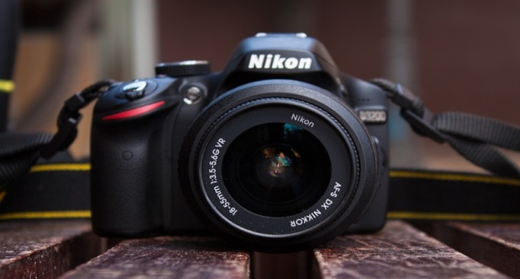
Breaking Down an Object into Vector
Since the following steps will involve a camera, looking at a camera:

Slide 6
Creating a Camera
Basic Vector Graphics in Illustrator

Slide 7
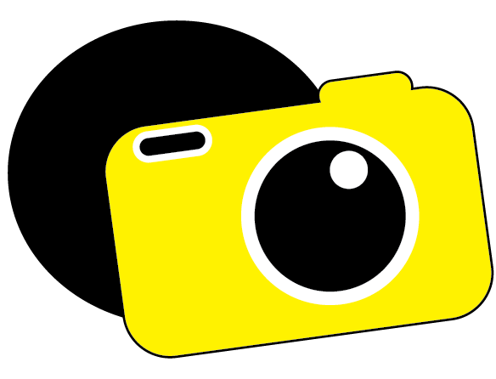
Overall Goals:
Begin with the idea of “Hey I want to make a camera!”
So we can look at the camera and break down the pieces:

Slide 8
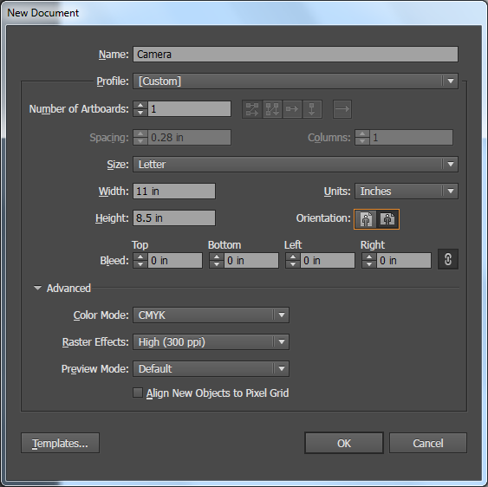
Creating our Document
Open Adobe Illustrator
On the main menu bar, choose File > New
Refer to the image:
Change Units to Inches
Change Orientation to Landscape (Leave at default size Width 11, Height 8.5)
Name your Document
Click OK

Slide 9
Create the Body of the Camera
Begin with selecting the Rounded Rectangle tool from the Toolbar
Remember – The Shapes are all collected as a group of tools, you may have to hold and select the Rounded Rectangle tool.
Use either the Toolbar or the Property Bar along the top to select your Fill Color For the Camera (I used Yellow).
Drag to create a yellow rounded rectangle – exact size won’t matter

Slide 10
Create the Body of the Camera
Begin with selecting the Rounded Rectangle tool from the Toolbar
Remember – The Shapes are all collected as a group of tools, you may have to hold and select the Rounded Rectangle tool.
Use either the Toolbar or the Property Bar along the top to select your Fill Color For the Camera (I used Yellow).

Slide 11
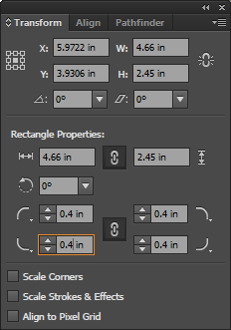
Tweak your shape
Open Transform panel by going to Window->Transform
Set the W: (width) to 4.66
Set the H: (height) to 2.45
Set the Corner radius to 0.4 (change one and all will update)
When the shape is drawn, Illustrator automatically keeps it selected for you

Slide 12
Here’s what we have

Slide 13
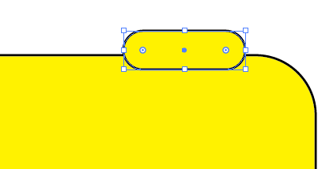
Additional Parts of the Camera
Using the Rounded Rectangle Tool again, go ahead and add the smaller flash area on top of the camera
Don’t worry the stroke is cutting into the lower rectangle, we have a tool to fix that

Slide 14
Additional Parts of the Camera
Shape Builder Tool: A tool that allows us to combine shapes together by merging them.
Select both of shapes using the Selection Tool
Switch to the Shape Builder Tool
When you hover over either shape you should see a mesh appear.
Click and hold in the body of the camera, then drag the cursor through the other shapes, making a line and causing the mesh to cover all the shapes.
Shape Builder Tool Game: https://helpx.adobe.com/illustrator/how-to/shape-builder-easy.html

Slide 15
Additional Parts of the Camera
So… to merge. click and hold on one shape and drag into the other shapes to merge them together.
Shape Builder Tool Game: https://helpx.adobe.com/illustrator/how-to/shape-builder-easy.html

Slide 16
Shape Builder Alternate Selection
Use the Selection tool, and make sure both rectangles are selected
Can either marquee select (Click + Drag)
OR Shift + Click each one

Slide 17
Additional Parts of the Camera
Once done, the final camera body should look like the follow:

Slide 18
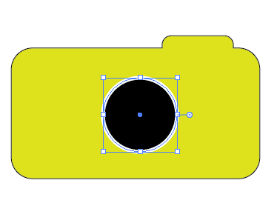
Adding the Camera Lens:
Deselect the camera
Choose the Ellipse Tool
Set the fill color to black and stroke color to white
Increase your stroke a bit – I used 5
Draw a Circle
Using the Shift key while dragging will make a perfect circle
Using the Alt key when first clicking will draw the circle from the center point – remember to keep shift pressed too.

Slide 19
Adding the Camera Lens:
Go Ahead and Add a circle:
Remember to deselect the previous circle
Swap the stroke and fill colors
Add another circle inside the camera lens:
Use the Ellipse Tool
Use a white fill, no stroke
Draw the circle

Slide 20
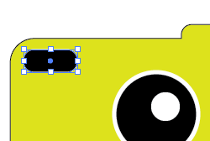
Adding the viewport:
Deselect the camera lens shapes
Choose the Rounded Rectangle Tool
Change the colors to a Black Fill and White Stroke
Draw the viewport in the upper left side of the camera

Slide 21
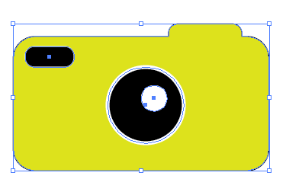
Rotate the Camera on an Angle
Make a marquee selection using the Selection Tool around the camera
Hover your mouse cursor on one of the corners of the bounding box till a curved arrow appears.
Click and hold to rotate the camera onto an angle

Slide 22
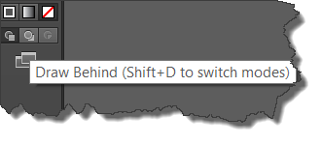
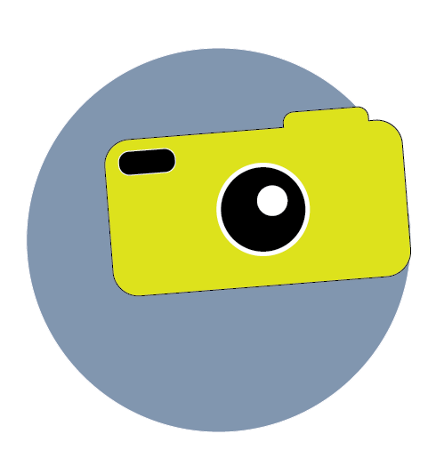
Adding the Background
Deselect the Camera and choose the Ellipse Tool
Pick a Stroke and Fill Color
At the bottom of the toolbox is a button to Draw Behind – Select it.
Add the circle to the camera

Slide 23
Closing
Continuing to practice enables the designer to begin to add their own flare to projects.
Simple is not always bad – minimalist design is very much back ‘in’ right now

