Slide 1
Digital Makeup

Slide 2
Objectives
Blend Mode options
Changing a layer’s opacity
Using the Brush tool
Using Gaussian blur
Using filter liquefy

Slide 3
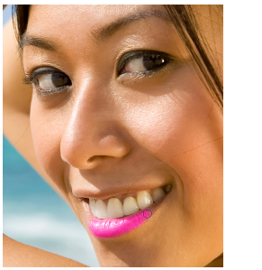
Download
Makeup.jpg
Blemish.png
Open in Photoshop
Switch to makeup.png

Slide 4
Fit on screen
View>Fit on Screen

Slide 5
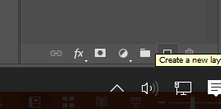
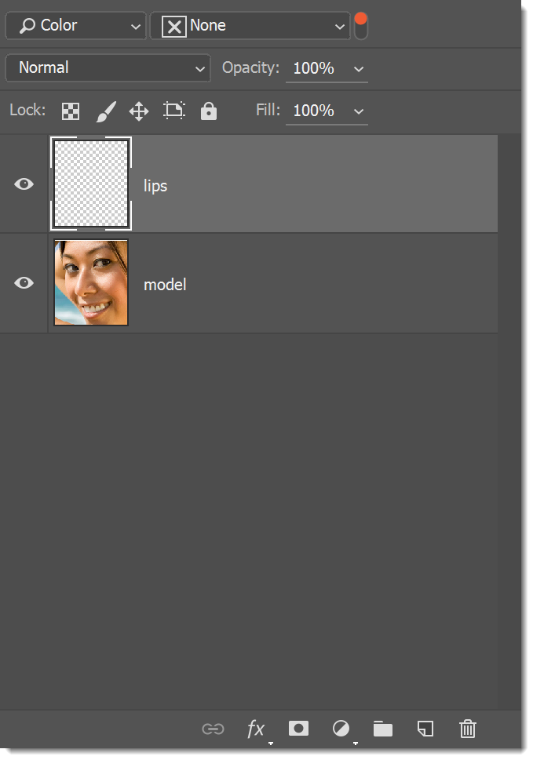
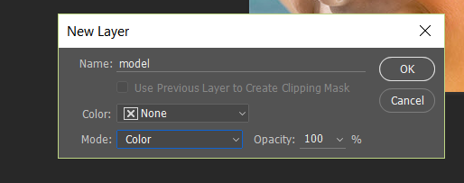
Layers
Should have a background layer
  Rename layer as model
Create a new layer and name it lips
Note: Always work with a new layer
Set ls Mode to Color…why?

Slide 6
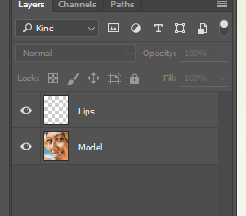
Layers Stack now
Lips layer is transparent

Slide 7
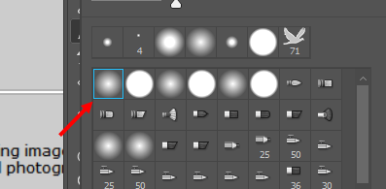
Choose Brush…(for lips)
Press B to activate the Brush tool or open from toolbox
Zoom way in
use the Brush Preset Picker in the Options Bar and
pick a soft-edged brush.

Slide 8
Lipstick Color
cmyk
5, 96,7,0
Choose lips layer
Zoom in
Brush her lips
Change brush size; use [and ]
Use a Large brush inside lips, smaller when near edges

Slide 9
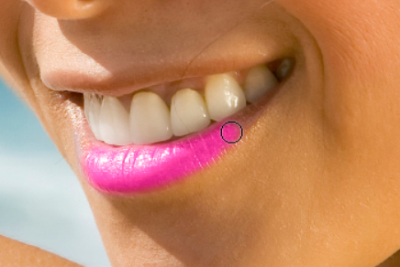
Lipsticks

Slide 10
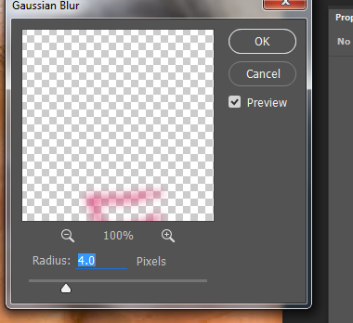
Blur lips
With the lips layer active, choose Filter>Blur>Gaussian Blur.
In the resulting dialog, experiment with the Radius to produce a very soft blur (try 4 pixels )
Check Opacity of lips layer; should be about 50%)

Slide 11
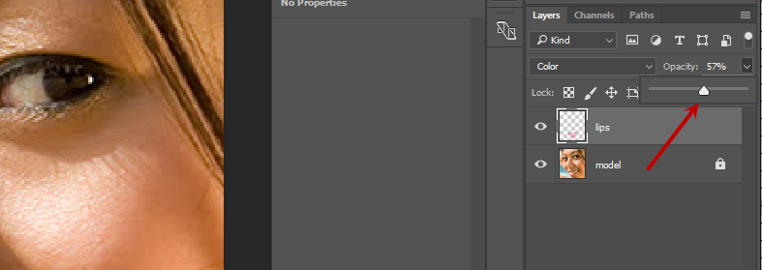
Opacity

Slide 12
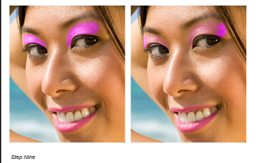
Practice
Draw with brush, rest below on your own
Add layers for shadow, blush
Add upper and lower eyelids
Eye liner on each
Before/after
  Here, you can see how the brush strokes were applied prior to lowering layer Opacity and blurring.

Slide 13
eyes
Should have eyes left, right
Brush eye-liner

