Slide 1
Photoshop & Photos (Cont.)
Moving, Cropping, Cloning & Image Resizing

Slide 2
Overview
Working with the Move Tool
Using the Crop Tool
Cloning Parts of an Image with the Clone Tool
Image Resizing & Prepping for Use

Slide 3
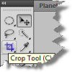
The Move Tool
Has two primary uses:
Can move a selection made by one of the selection tools or,
Reposition an entire layer
To control the Move Tool:
Select the Tool (v key or select)
Click and drag, or
Use the arrow keys for more precise movement,
a process called nudging
Photoshop CC2015
Photoshop CC & Back

Slide 4
The Move Tool
Returning to ThreePix.PSD:
Choose a selection tool and select the top of the building
Activate the Move Tool
Go back to the canvas and Click + Drag to move the selection around
Creating the Selection
Moving the Selection

Slide 5
The Crop Tool
Used to select an area of an image
Anything outside the selected area is discarded and the new selected area is the ‘main’ image.
To use the Crop Tool:
Select the Crop Tool in the Tool Box
Select the area of the image with the Crop Tool you’d like to use
Note: When you release the selection – the area that is being cropped to is still colored however everything outside the cropped area is greyed out (darkened)
At this point the cropped area can be moved, rotated and resized before committing the changes
Hit the Check Button on the Property Bar or Enter to commit to the cropped area

Slide 6
Resize the canvas using the Crop tool
From the toolbar, select the Crop Tool . Crop borders display on the edges of the image.
Drag the crop handles outwards to enlarge the canvas. Use the Alt/Option modifier key to enlarge from all sides.
Press Enter (Windows) or Return (Mac OS) to confirm the action.

Slide 7
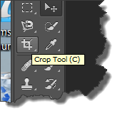
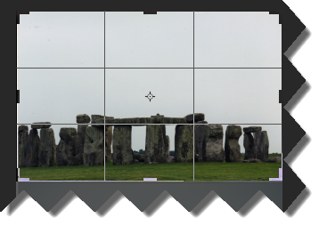
The Crop Tool
Using ThreePix.PSD, crop the wide shot of Stonehenge
Choose View > Fit on Screen
Draw a rectangle around the area to crop using the Crop Tool
Select (Crop) just the wide angle Stonehenge picture
Use the resize handles to clean up the selected crop area
Notice the Crop Tool also shows the Rule of Thirds to help with selecting
Use the Enter Key, The Check Mark on the Property Panel, or:
Image > Crop, Right Mouse Click > Crop

Slide 8
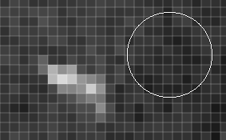
Clone Stamp Tool Definition
The Clone Stamp tool paints one part of an image over another part of the same image or over another part of any open document that has the same color mode. You can also paint part of one layer over another layer. The Clone Stamp tool is useful for duplicating objects or removing a defect in an image.
To use the Clone Stamp tool, you set a sampling point at the area you want to copy (clone) the pixels from, and paint over another area.
To paint with the most current sampling point whenever you stop and resume painting, select the Aligned option. Deselect the Aligned option to paint starting from the initial sampling point no matter how many times you stop and resume painting.
Here, in the middle image, I’ve taken a sample to the right of the white blemish (circle). Then, in right image, I’m “painting” over the blemish with the sampled texture.

Slide 9
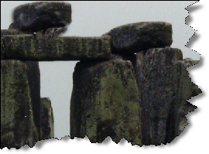
Clone Stamp Tool Summary
Copies pixels from one location and pastes them in another
Aka ‘Rubber Stamp’
This tool tells Photoshop two things:
Source of the pixels (what pixels to pick up)
Destination (where to drop the pixels)
Using the Clone Stamp Tool on the ThreePix.psd document, add another rock to the Stonehenge picture.

Slide 10
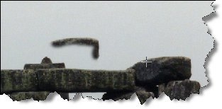
Using Clone Stamp Tool
Select the Clone Stamp Tool – Notice how the cursor has changed to a circle
Alt + Click an area of the rock:
Designates the starting source of the pixels to be copied (in this example, the rock)
When holding down the Alt key, the cursor changes to look like a bulls-eye
Now a circle appears where the Alt + Click occurred, represents the brush size, how hard the brush is and the location of the sampling.
Begin to Paint/Draw where the pixels should be copied to
Pay attention to the source reference cursor, to stay in the rock area
The plus symbol notes what pixels are being picked up

Slide 11
Using Clone Stamp Tool 2
Alt + Click several times as the new rock is drawn, this is called resampling
Once completed, there should be a new rock appearing on the Stonehenge.

Slide 12
Healing Brush Tool
The Healing Brush tool lets you correct imperfections, causing them to disappear into the surrounding image.
Like the cloning tools, you use the Healing Brush tool to paint with sampled pixels from an image or pattern.
However, the Healing Brush tool also matches the texture, lighting, transparency, and shading of the sampled pixels to the pixels being healed. As a result, the repaired pixels blend seamlessly into the rest of the image.

Slide 13
SPOT Healing Brush Tool
The Spot Healing Brush tool quickly removes blemishes and other imperfections in your photos.
The Spot Healing Brush works similarly to the Healing Brush: it paints with sampled pixels from an image or pattern and matches the texture, lighting, transparency, and shading of the sampled pixels to the pixels being healed
. Unlike the Healing Brush, the Spot Healing Brush doesn’t require you to specify a sample spot.

Slide 14
Patch tool
The Patch tool lets you repair a selected area with pixels from another area or a pattern. Like the Healing Brush tool, the Patch tool matches the texture, lighting, and shading of the sampled pixels to the source pixels. You can also use the Patch tool to clone isolated areas of an image.

Slide 15
Content-Aware tool
The Content-Aware option in the Patch tool synthesizes nearby content for seamless blending with the surrounding content.

Slide 16
DO these tutorials to practice
https://helpx.adobe.com/photoshop/how-to/remove-objects-fix-flaws.html

Slide 17
Image Resizing & Prepping for Use
Working in graphics today – Two primary things that will be done with finished graphics
Incorporated into Print Designs and Layouts (i.e. Brochures, Magazines, etc.)
Incorporated into Web Designs and Layouts (Web Sites, Apps, etc.)
Print Design and Layouts:
Color Scheme used is CMYK (Cyan, Magenta, Yellow, Black)
Due to printing DPI (dots per inch) it is common practice to double the PPI (pixels per inch) in graphic programs such as Photoshop
When preparing to print – the graphic should be 300 ppi
Web Design and Layouts:
Color Scheme used is RGB (Red, Green, Blue)
Due to differing Internet connections (T1, Cable, 56k, etc.), designers are more concerned with download speeds of images and will reduce the PPI of the graphic
When preparing for Web – the graphic should be 72 ppi
Note: Monitors are becoming higher resolution though, and the 72 ppi is becoming a myth.

Slide 18
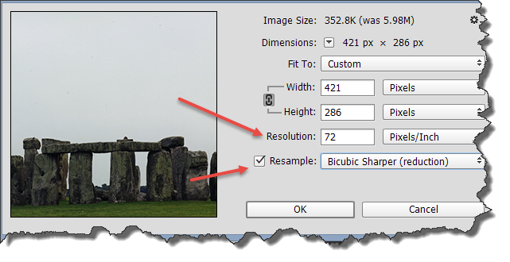
Image Resizing & Prepping for use
On the Main Menu bar of Photoshop – select Image > Image Size
Primary means of changing image sizes for the entire image
Looking at the ThreePix.psd document, notice the ppi is 96.
Change the ppi to 72 ppi.
Change and check the Resample drop down to Bicubic Sharper
It is easier to remove pixels and reduce the size of an image than it is to add pixels to an image and make it larger. Work with as high resolution images as possible!

