Slide 1
Photoshop
Introduction & Getting ready to work

Slide 2
Class Overview
Photoshop Interface
Resetting the Interface
Creating a New File
File Types that can be created & color types
Saving Files in Photoshop
The differences between ‘working file (psd)’(…’ and ‘published file’ jpg, png)

Slide 3
Photoshop
Interface Controls & Layout

Slide 4
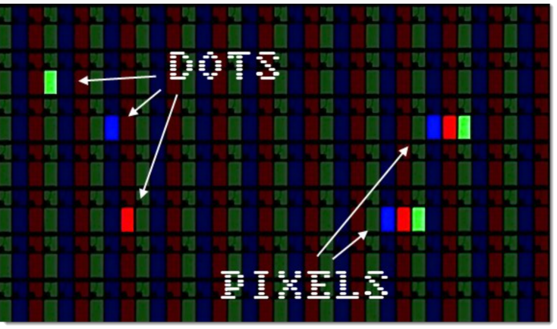
So what is Photoshop?
Just to recap –
Photoshop is a pixel based design environment that allows designers to create and manipulate graphics
Pixel
Also known as picture elements – these small ‘dots’ combine together to create images on a screen.

Slide 5
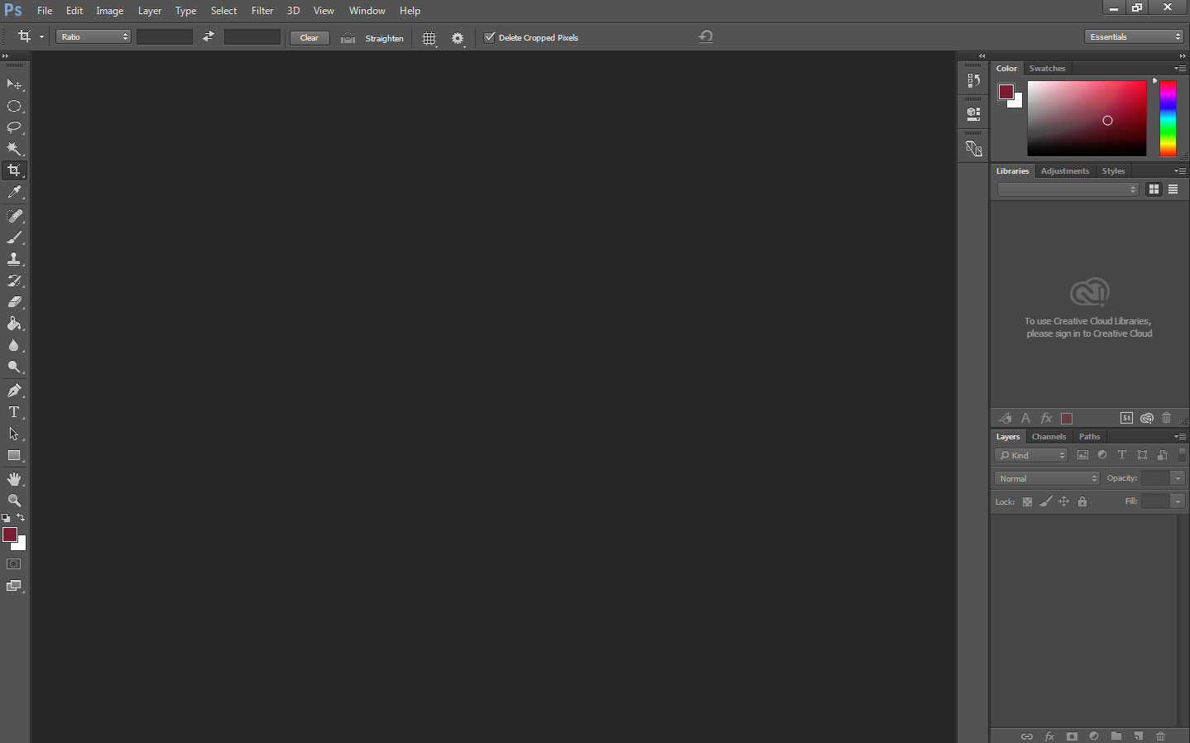
Base Interface of PS

Slide 6
Base Interface of PS
This is the main work space – Files are displayed here and this is the main area where editing will occur.

Slide 7
Base Interface of PS
Panels – Each of the panels shown control different aspects of PS projects. In this view you can see the layers panel which is one of the integral panels in PS. The smaller icons on the left are collapsed panels that can be expanded when clicked on.

Slide 8
Base Interface of PS
Toolbar – All the necessary tools to work with in PS. These tools cover everything from selections to healing photos to creating text and shapes. NOTE: While there will be variation – the toolbar is common across all three programs we will be working with.

Slide 9
Base Interface of PS
Property Bar – Depending upon what tool is active, this bar will change the displayed options to relevant options to the specific tool that is currently active. Pay attention to this!

Slide 10
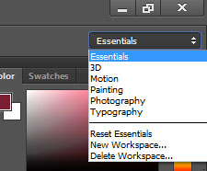
Resetting the Interface
PS offers different pre-defined layouts for different purposes.
If by accident you close a panel:
Use the upper right drop down and select ‘Reset Essentials’
This will return you to the default panel layout for Essentials

Slide 11
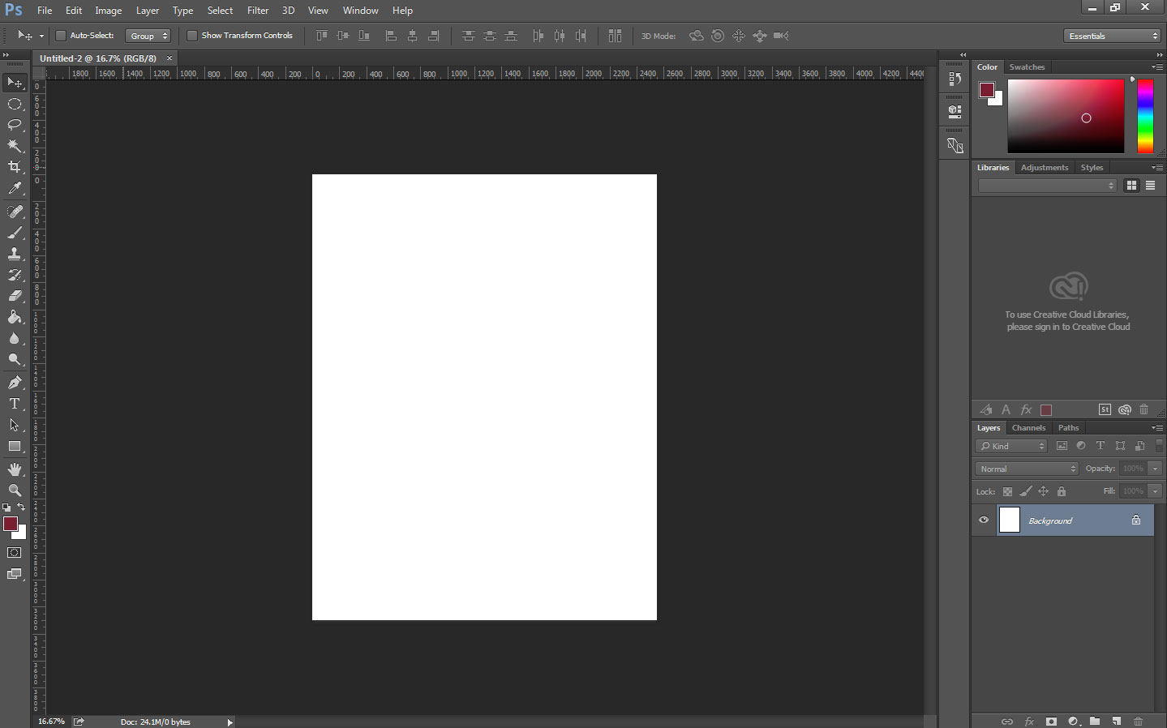
Base Working Interface of PS
Here we see a new document open – Notice how the Layers Panel has changed to reflect the Background Layer of the File.

Slide 12
Creating a New Document in PS
Knowing which type of file & measurements to use when!

Slide 13
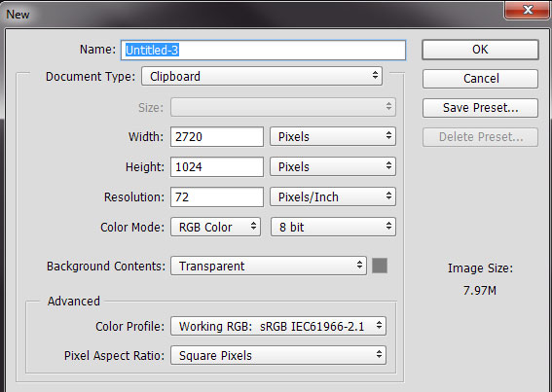
Creating a New Doc in PS
You can define specific document types to meet your needs.
Under the Document Type Dropdown, PS provides presets for you as well depending on your project type.
Major Project Types Include:
Web/Mobile
Video
Print
Any of the above types – measurement values, Color Modes and Resolutions can change!

Slide 14
Saving a Photoshop Document
File Types and Saving

Slide 15
Saving a PS Document
Normally, you will have two types of documents when working in any Adobe Product:
Working File: This is a file that has an extension specific to the program you are working in. It will preserve all working assets allowing you to return and work on the file later.
Published File: This file has been ‘smooshed’ down and does not preserve any editing capabilities for the program.
Through the course, make sure to keep track of your working file format.

Slide 16
Saving a PS Document
Working File Extensions:
.PSD (Photoshop)
.AI (Illustrator)
.INDD (InDesign)
Published Files
.JPG, .GIF, .PNG (Web)
.PDF (Acrobat)
.TIFF

Slide 17
Saving a PS Document
To save a PS Document:
File > Save (or Ctrl+S): Saves your PSD for you as you work if you have already given it a file name.
If not, you will be prompted to give your file a name.
File > Save As: Opens a new window with a drop down allowing you to select the file type you wish to save your document as.

